Slide 1
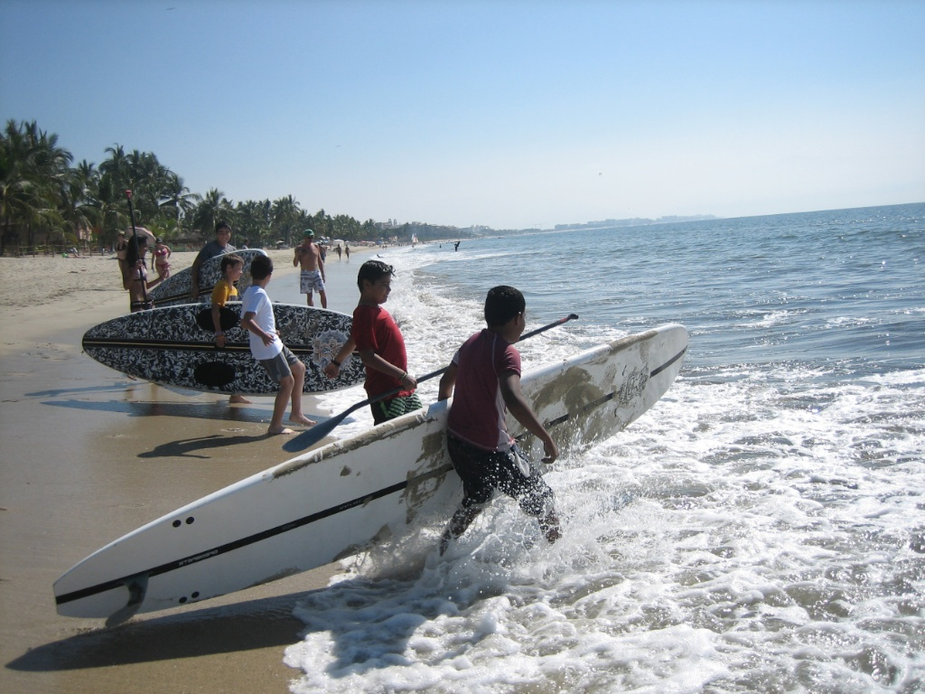

Direction Map to
Pulau Indah for Stand Up Paddling and Windsurfing Sports

Slide 2
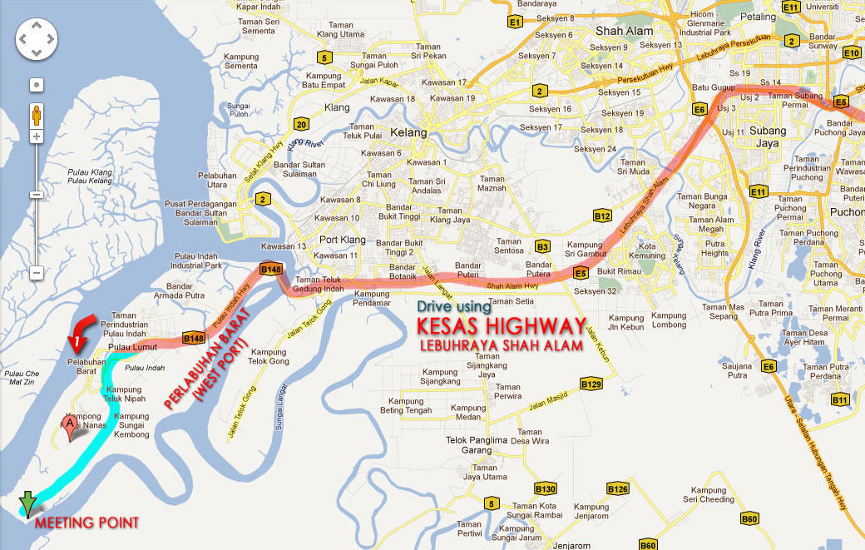
GPS: N 2 53.195 E 101 16.9889
Google Map http://g.co/maps/6f6v2

Slide 3
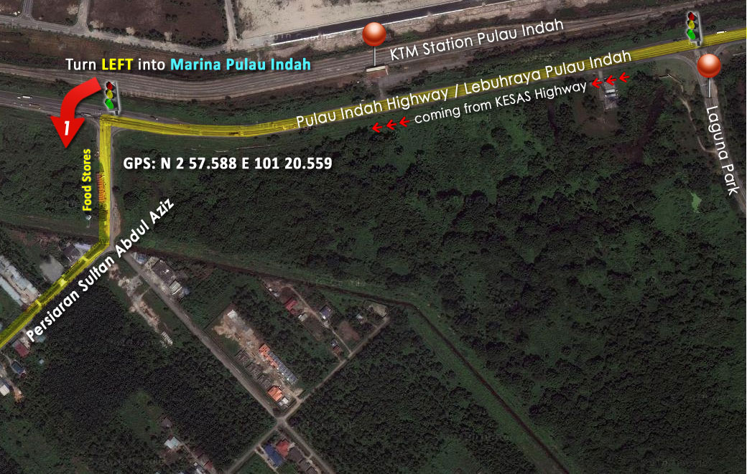
GPS: N 2 53.195 E 101 16.9889
Google Map http://g.co/maps/6f6v2

Slide 4
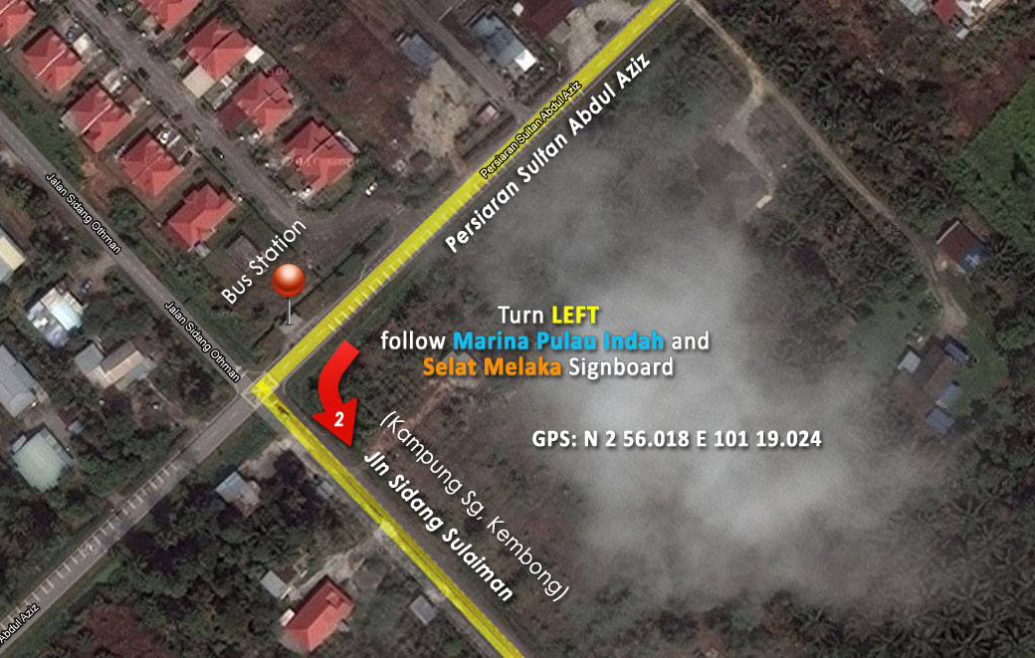
GPS: N 2 53.195 E 101 16.9889
Google Map http://g.co/maps/6f6v2

Slide 5
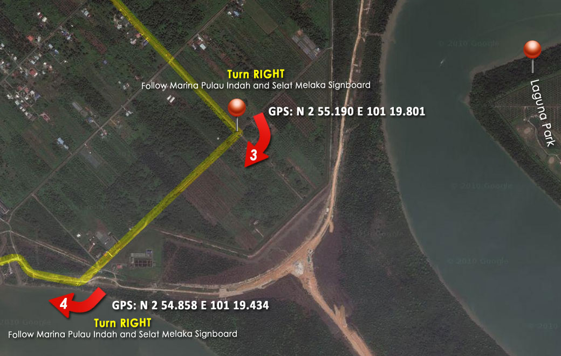
GPS: N 2 53.195 E 101 16.9889
Google Map http://g.co/maps/6f6v2

Slide 6
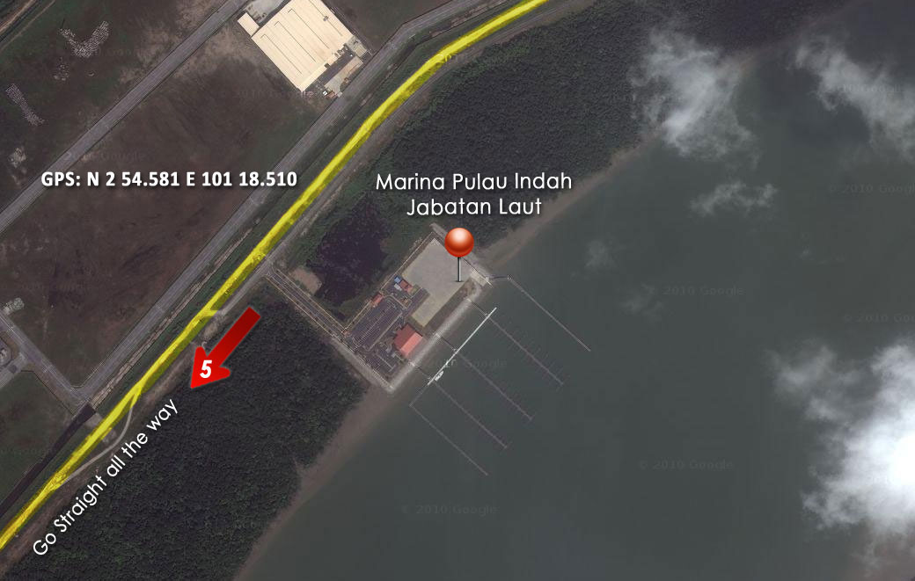
GPS: N 2 53.195 E 101 16.9889
Google Map http://g.co/maps/6f6v2

Slide 7
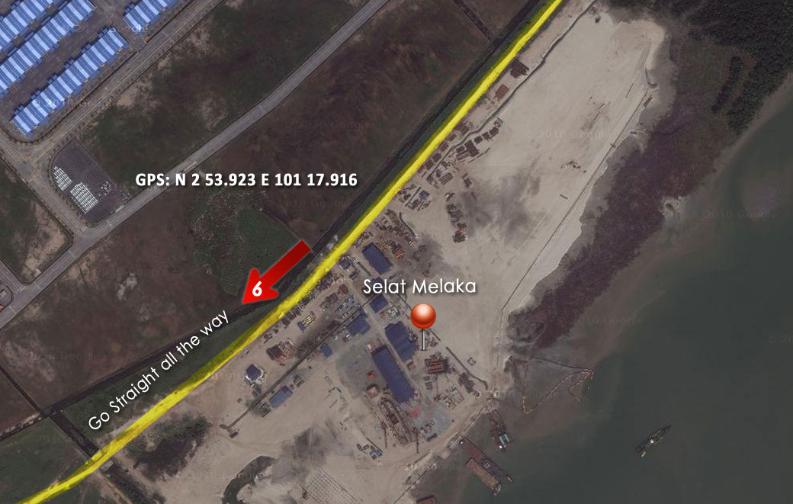
GPS: N 2 53.195 E 101 16.9889
Google Map http://g.co/maps/6f6v2

Slide 8
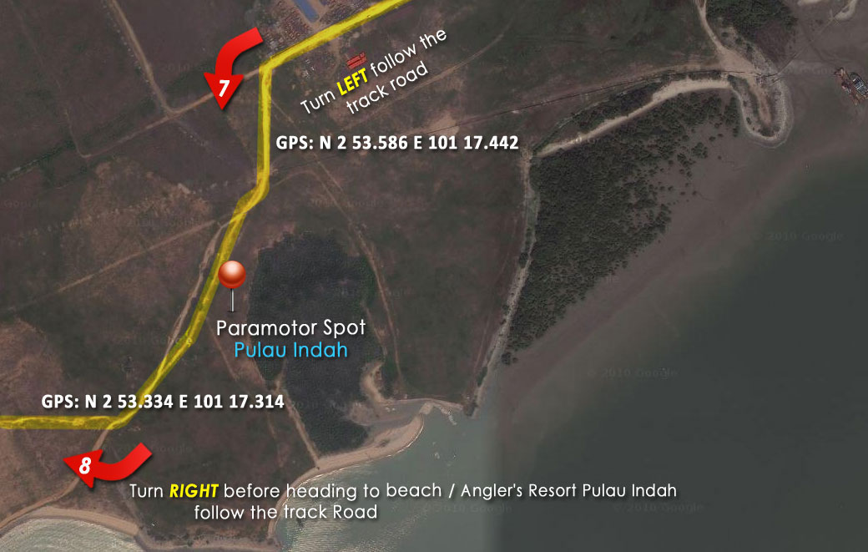
GPS: N 2 53.195 E 101 16.9889
Google Map http://g.co/maps/6f6v2

Slide 9
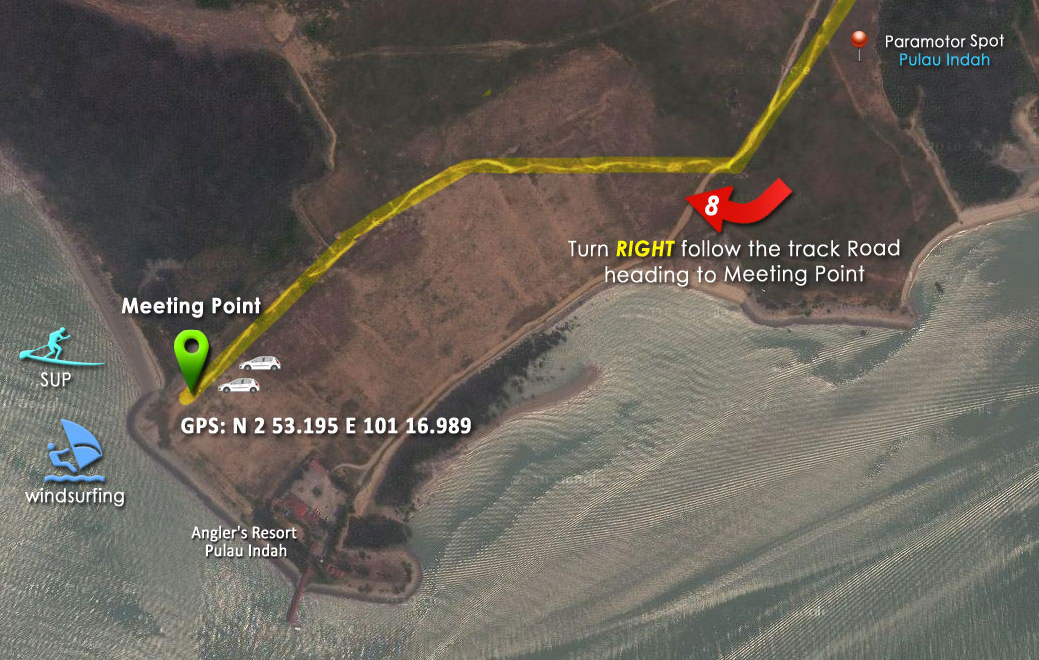
GPS: N 2 53.195 E 101 16.9889
Google Map http://g.co/maps/6f6v2

